Slide 1
Burning Glass xCase
Zac Boiskin
Level Full-Time
Boston

Slide 2
Methodology Step 1: Cleaning in R
Rstudio:
Replaced “-999” in Occupation Code to “0”
Idea was that 0s would cause less issues if any calculations were applied
Replaced any NULL spaces with the word “None”
Idea was to change the data type of NULLs from factors for consistency
1. Identify and NULLs by identifying them as factors
2. Changed into “None”
3. Converted them back to characters and back into main data frame
Created new IDs for Columns that do not have with their respective row name
Created new child tables with the entity and a unique ID

Slide 3
Methodology Step 2: Table Creation
SQL:
Uploaded tables into CSVs to be imported into SQL
Created template tables for main data and child joining tables
Set conditions of data types such as “Salary” as integers and conditions for row termination
Created many to many relationship tables:
Jobs ID -> Certification, Majors, Skills and Degree type
Removed any unwanted “”s or ,s

Slide 4
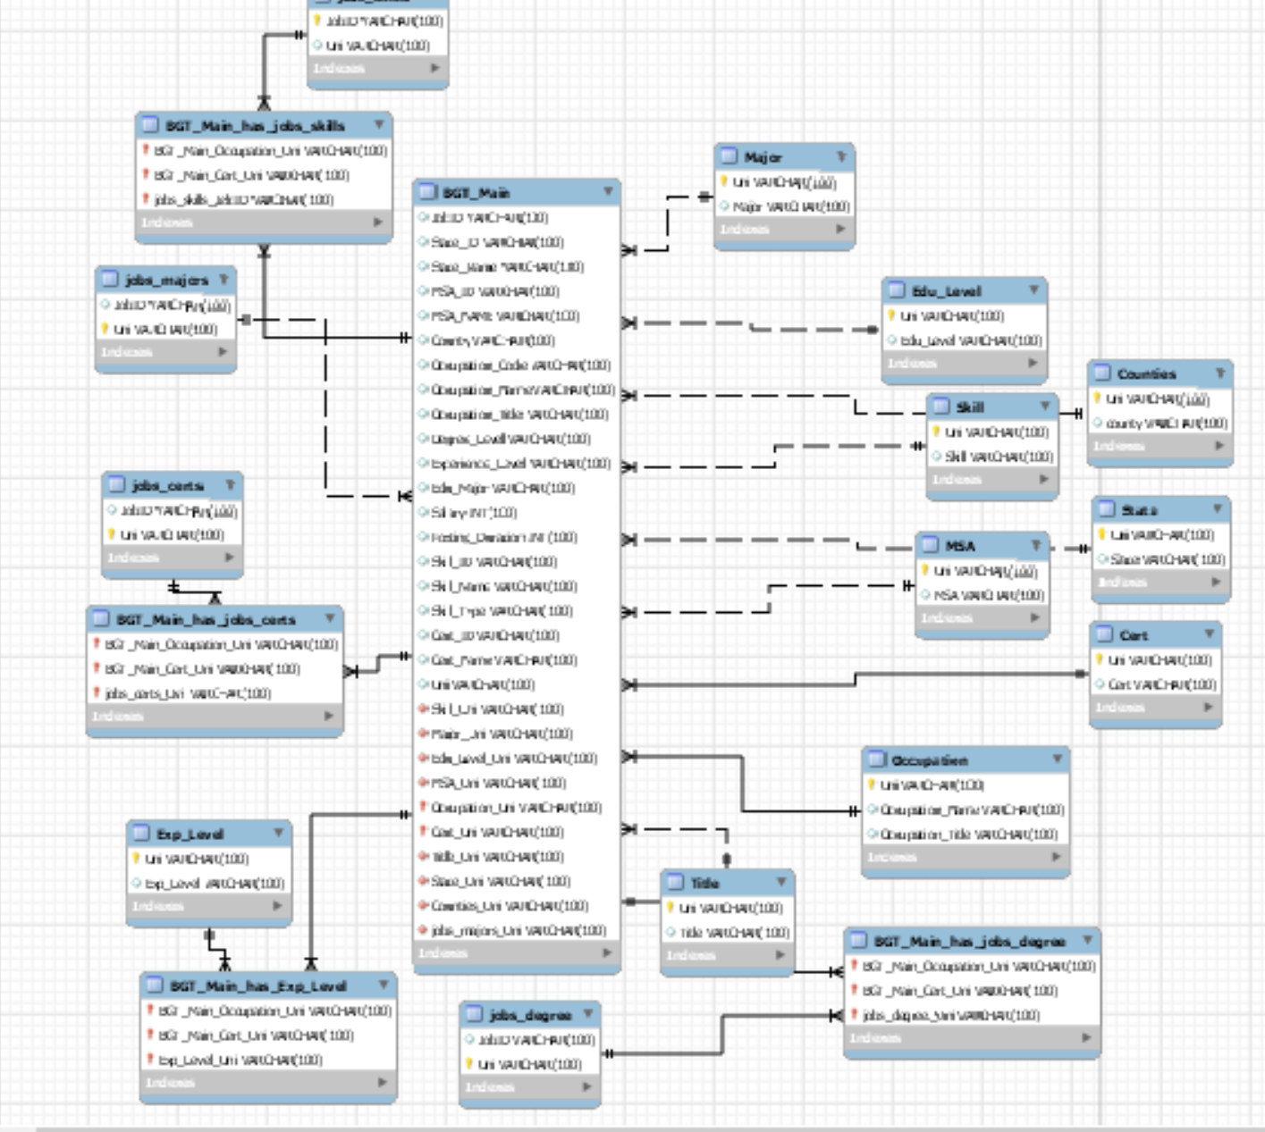
Schema

Slide 5
Question: Does the degree obtained give the person the most desired skills they need for the top jobs that fall under that degree category?

Slide 6
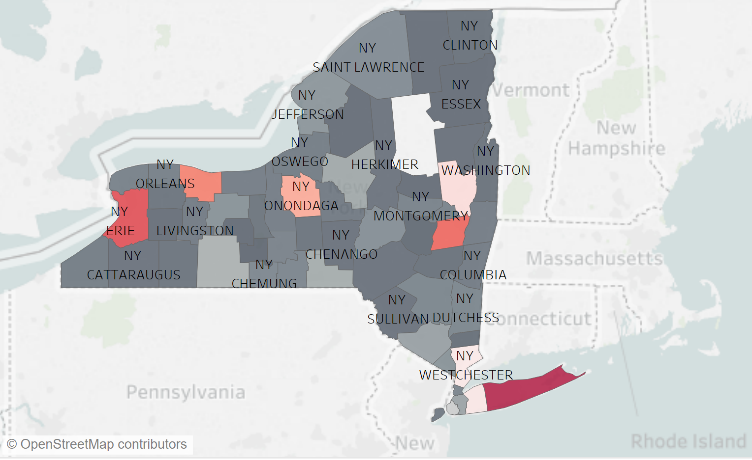
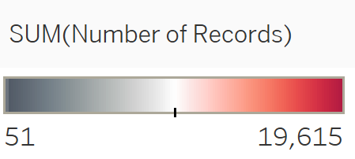
New York State’s Counties*
*New York City excluded due to altering average. NYC Job Count = 199,690

Slide 7
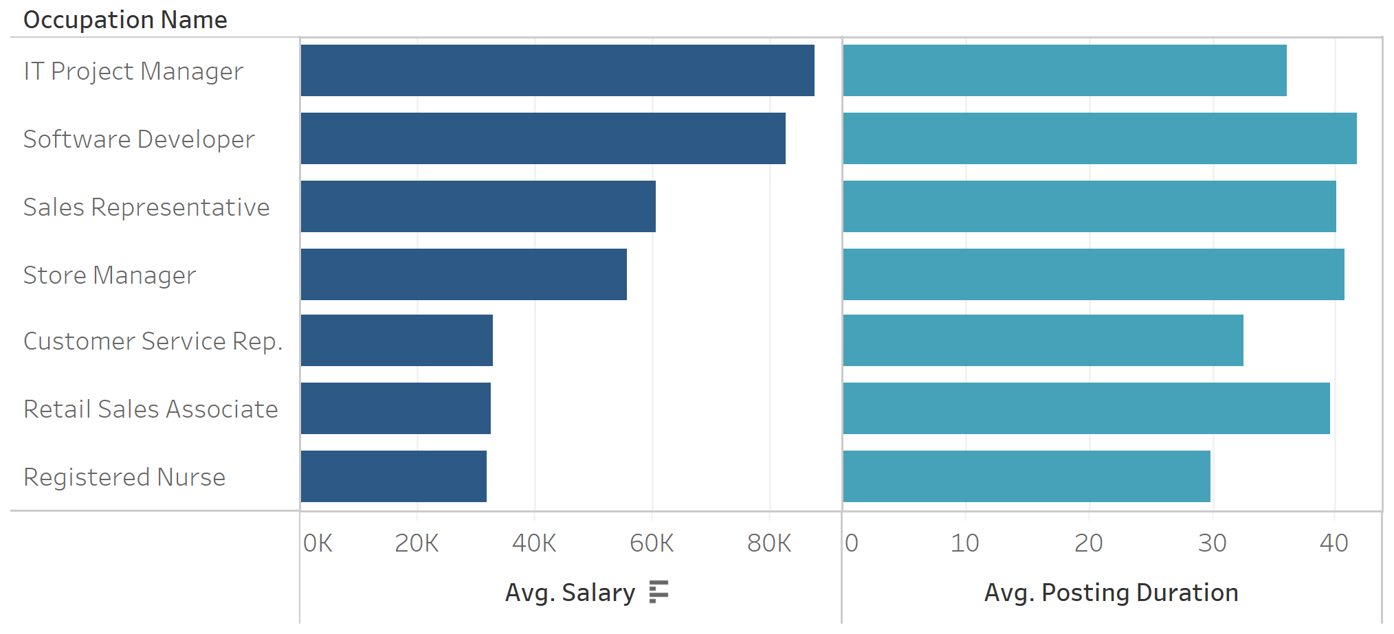
H.S./Vocational Training – Salary vs. Posting Duration
Assuming they follow a pattern. Proactive or Reactive?

Slide 8
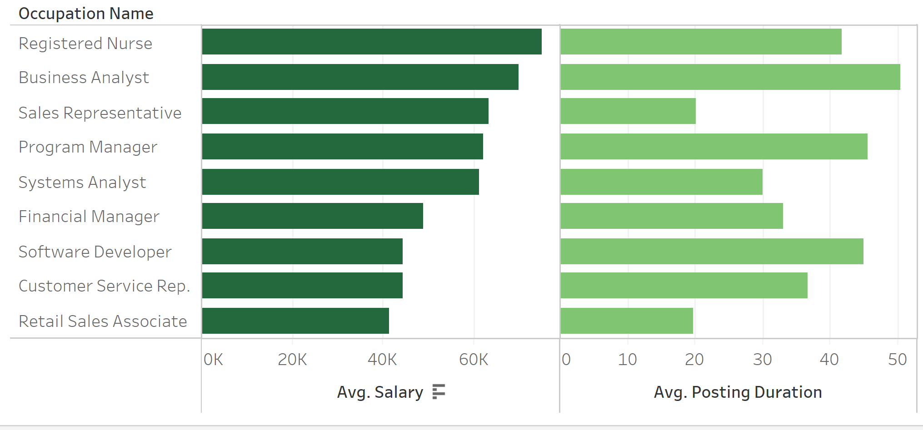
Associate’s Degree – Salary vs. Posting Duration
Posting duration has more variation

Slide 9
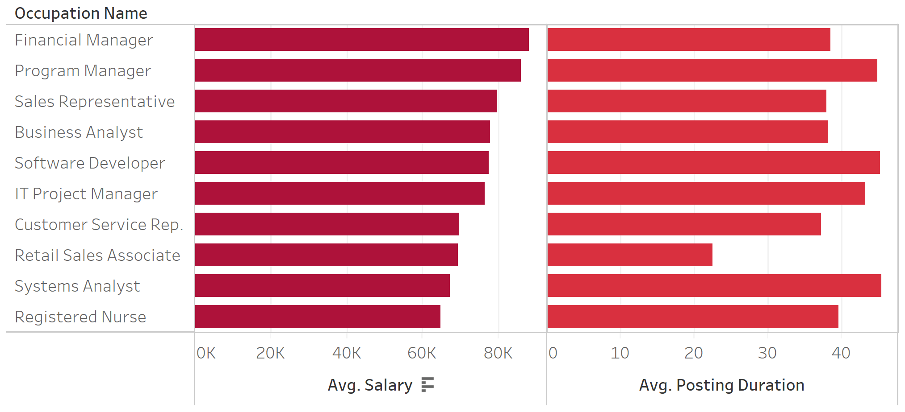
Bachelor’s Degree – Salary vs. Posting Duration

Slide 10
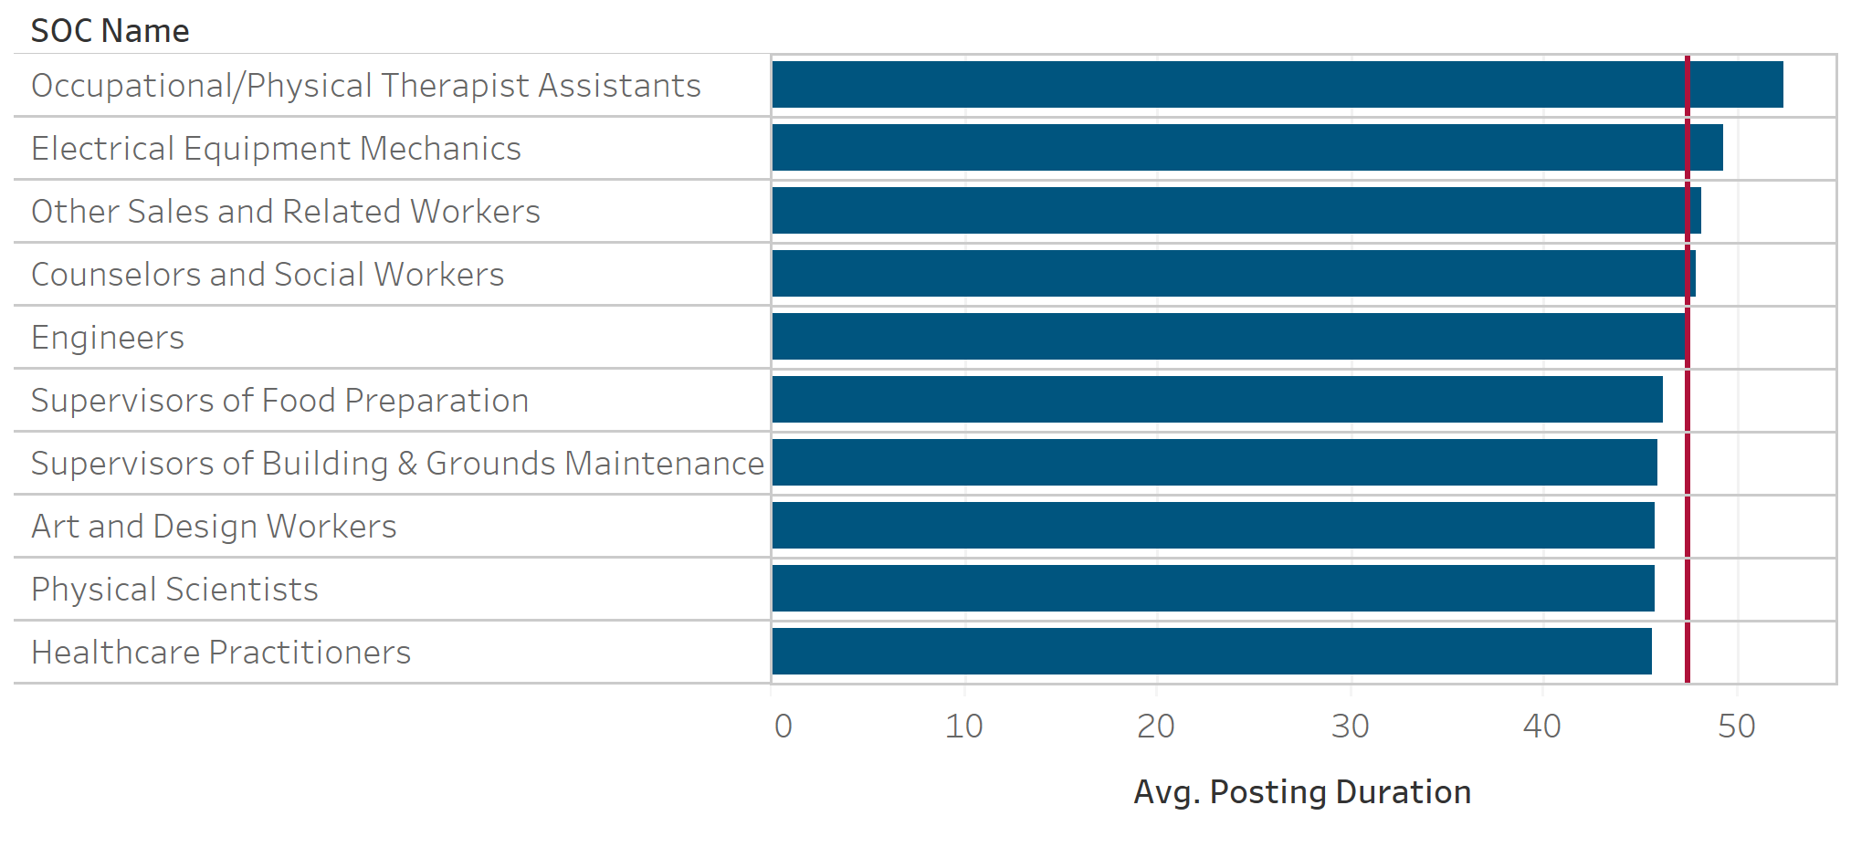
Standard Occupational Classification (SOC)
Total Postal Duration Avg. = 47.5

Slide 11
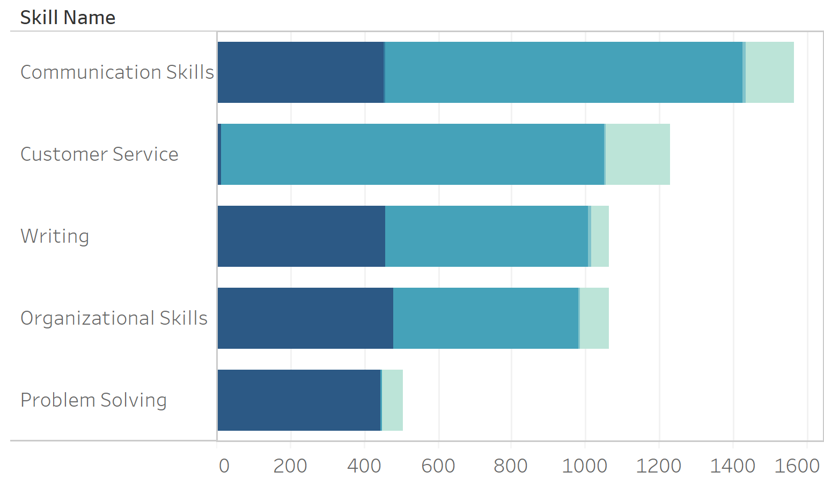
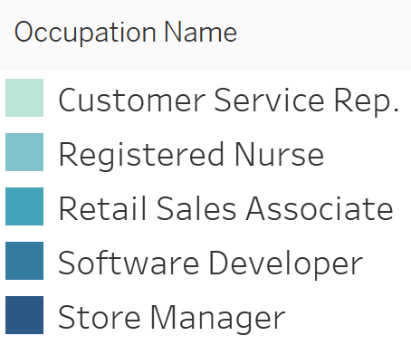
H.S./Vocational Training Degree Jobs
What are the top desired skills per degree?

Slide 12
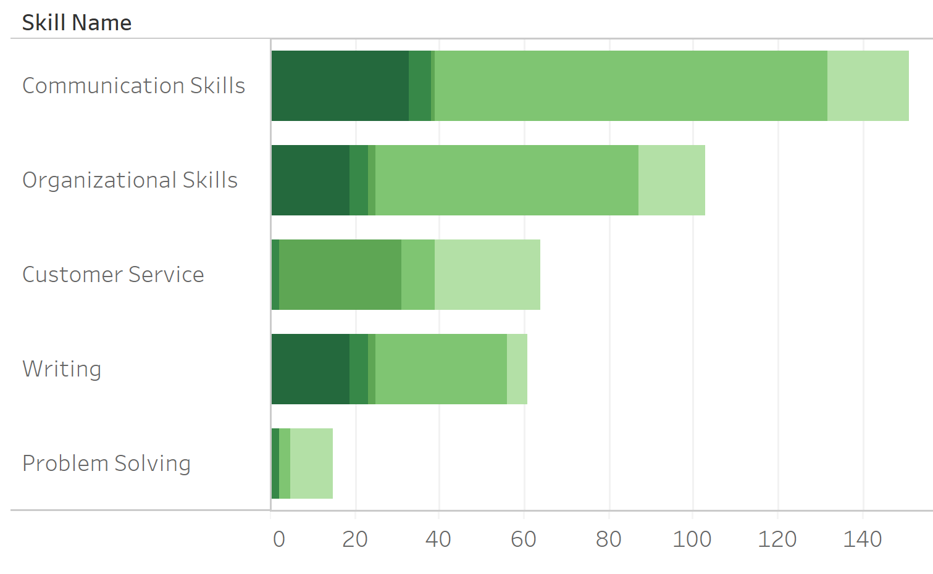
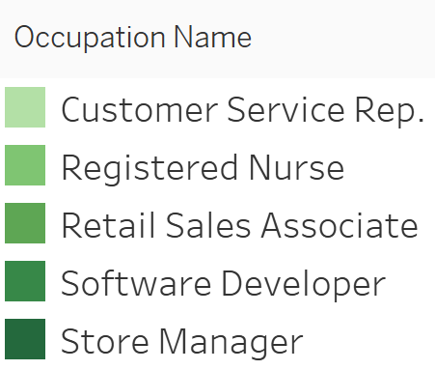
Associate’s Degree Jobs
What are the top desired skills per degree?

Slide 13
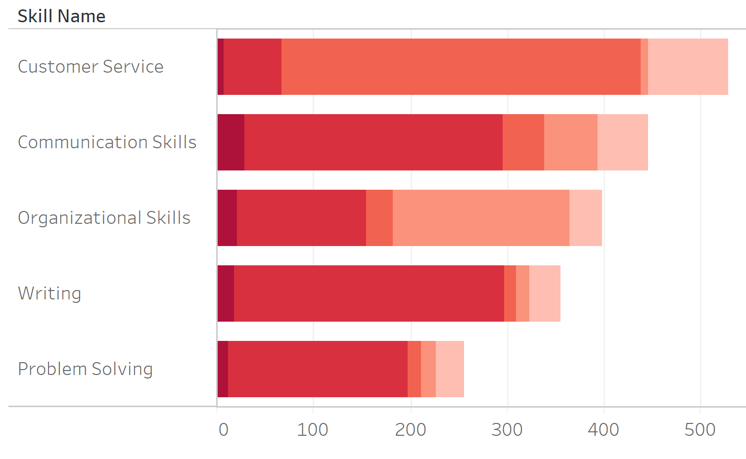
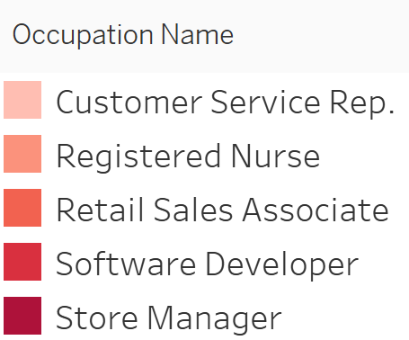
Bachelor’s Degree Jobs
What are the top desired skills per degree?

Slide 14
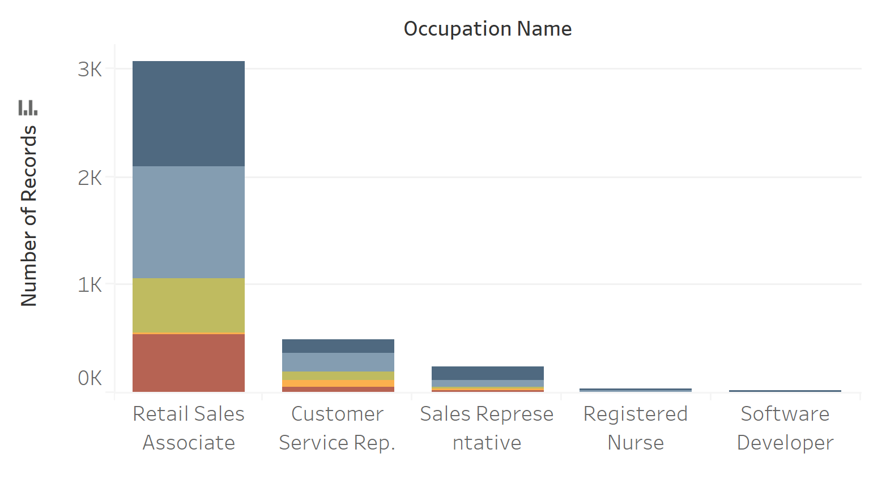
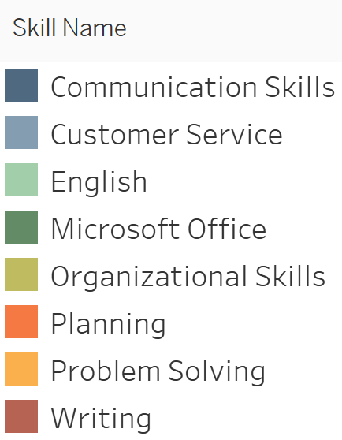
H.S. Skills Gap
Higher the stacked column, the better prepared the average graduate is for that postion

Slide 15
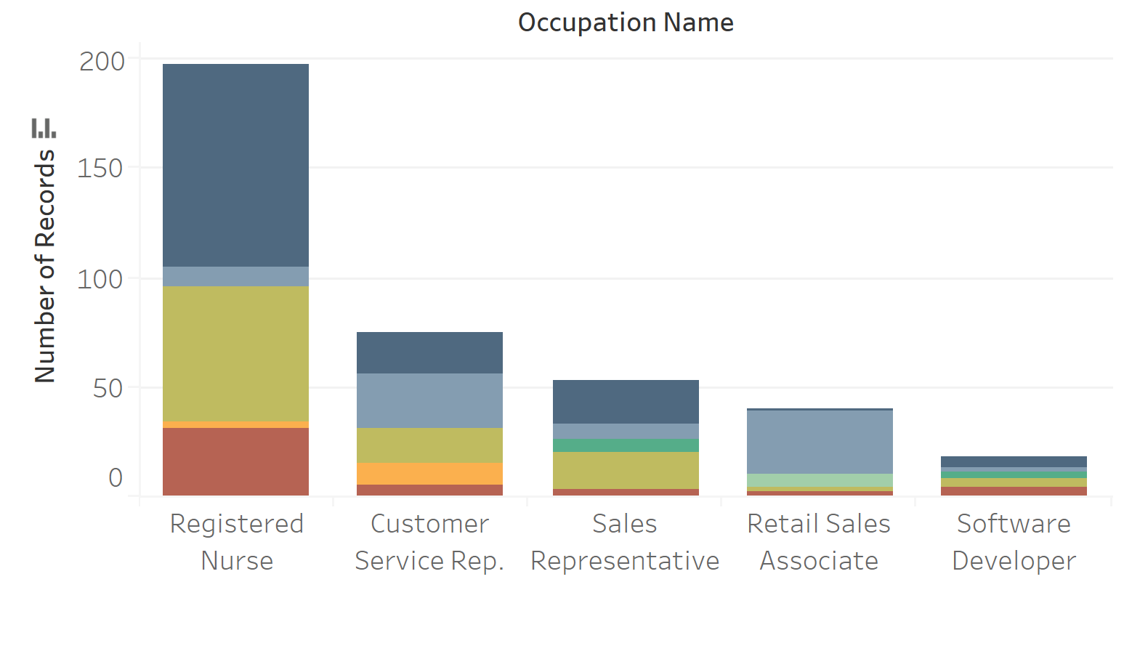
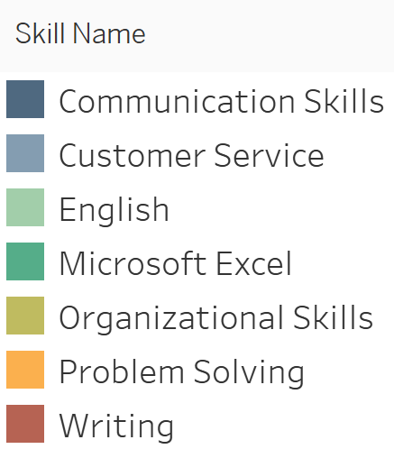
Associate’s Degree Skills Gap

Slide 16
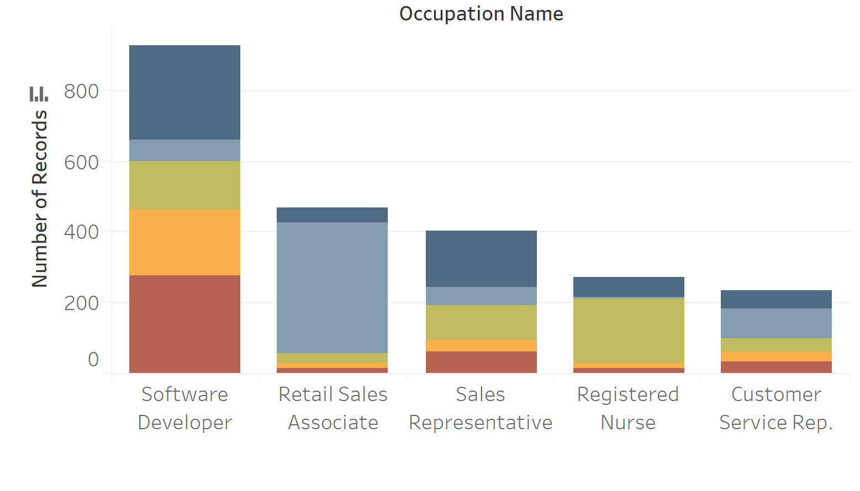
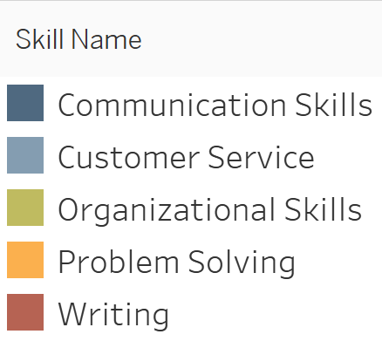
Bachelor’s Degree Gap

Slide 17
Degree Comparison - Skills Gap
H.S./Vocational
Associate’s Degree
Bachelor’s Degree

Slide 18
Conclusion
Degree programs should adopt a more top down approach
Viewing labor stats or job databases to see skills and positions that are most in demand
More curious to see vocational training separated from a high school degree
Bachelor’s degree has the smallest skills gap, but still room for improvement

